Slide 1


Big Data and Text Analytics
Final Project
Mei Ming

Slide 2

Executive Summary
This project seeks to contribute to an understanding how University of Chicago can be further improved by exploring the original tweet and re-tweet text data.
Data source related to University of Chicago was pulled out from RCC. IBM SPSS model and text analytics packages were used for text and sentiment analysis.
The top themes about original tweet and re-tween are Medicine, class, professor, hiring, law and Department, professor, class, respectively. Medical school and law school now gain more public attention, which are good signs. University of Chicago should keep investing or hiring for its medical school, and build connection with its alumnus from law school, which will help increase its reputation and get financial fund.
By exploring the sentiment analysis, the negative comments gain more public attention and follows, compared with positive comments. There are a lot tweets about the professors’ sexual harassment issue, racist and class violence. University of Chicago should take some actions to prevent the students/victims from the professors’ sexual assault and prevent attack on campus, avoid class violence.

Slide 3
Methodology and source data overview
Data source: six keywords (uchicago, university of Chicago, @Uchicago, @uchicagonews, #Uchicago, #uchicagonews) related to University of Chicago were used to pull out tweet date set from RCC.
IBM SPSS was used to clean, subset the data. IBM SPSS text analytics packages were used for text analysis and sentiment analysis.
Only English (language) was selected for further text analysis.
Original tweet and re-tweet relevant to University of Chicago were analyzed separately for top themes.

Slide 4
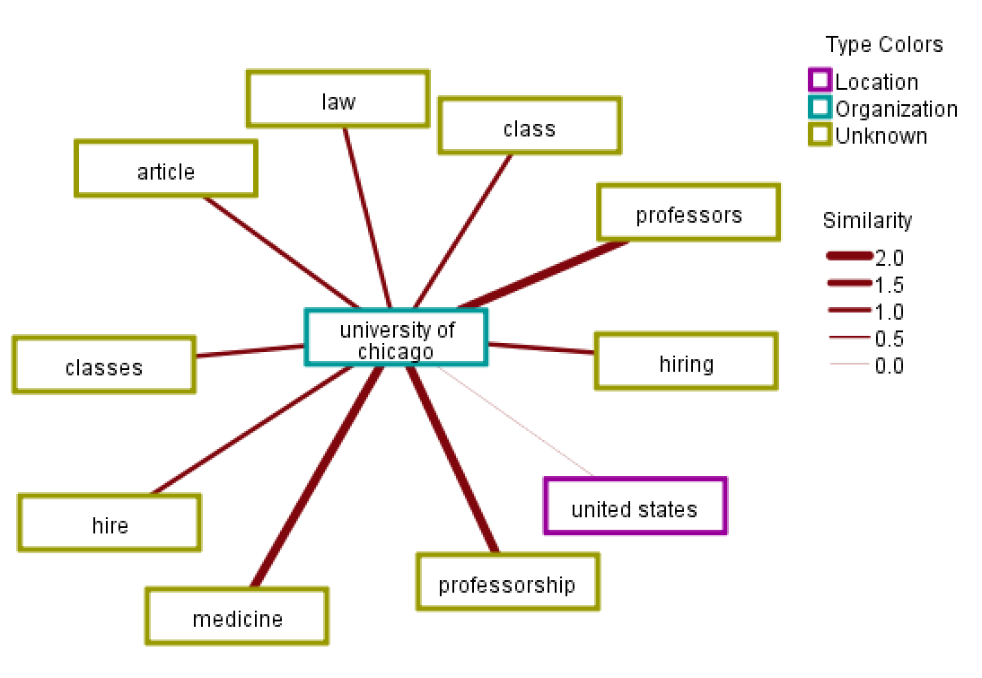
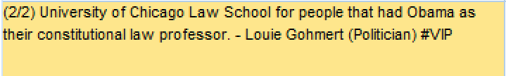
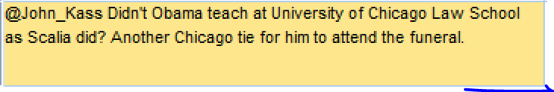
Original tweet for University of Chicago
Total Tweet count: 17885
Top themes
Medicine
Professor
Class
Hiring
Law
Analysis:
Theme Medicine ranks top for original tweet, which indicates that University of Chicago Medicine gains more attentions and follows. It’s a good sign that U of C medical school gains more reputation and ranks higher.
One of another theme ranks top is hiring, which indicates that University of Chicago is trying to increase its hiring and recruit more distinguished faculties to help establish its reputation world widely.
Law is another top theme, which might be relevant to President Obama, since he used to work at law school at University of Chicago.

Slide 5

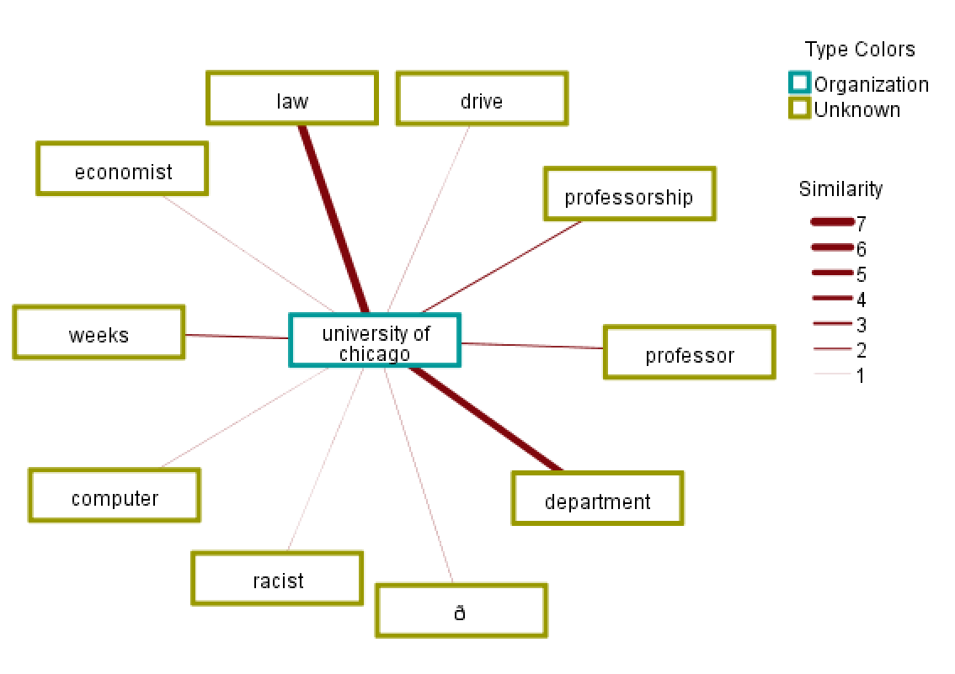

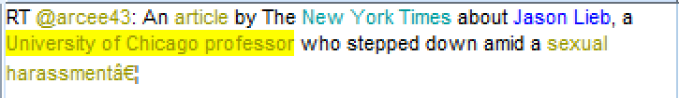
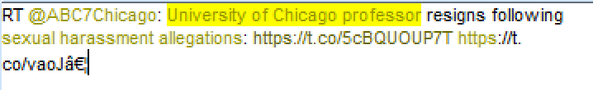
Re-tweet for University of Chicago
Total Re-Tweet count: 15697
Analysis:
Top themes for re-tweet count is department, including biology, microbiology, human genetics, etc. These topics are related to research in academics, which indicates that University of Chicago put a lot effort on research in order to gaining more reputation.
Another top theme is professor. There are a lot of complaints about the improper behavior or sexual harassment issue. Some actions or preventive steps must be taken to stop it.
Top themes
Department
Law
Professor
Weeks
Computer

Slide 6
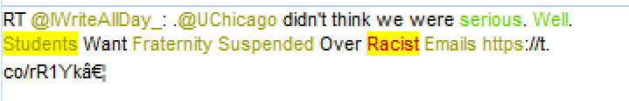

Sentiment analysis for University of Chicago
 | Original tweet | Re-tweet | Ratio
University of Chicago | 11977 | 13185 | 1.1
Positive | 575 | 474 | 0.8
Negative | 2095 | 5410 | 2.6
Sentiment analysis:
Overall, there are more negative attitude towards University of Chicago, regardless original tweet or re-tweet. Especially for re-tweet, it mainly focus on negative comments, which indicates that negative comments could gain more attention and follows, compared with positive comments.
In terms of University of Chicago professor, there are several times more negative comments compared with positive ones. For re-tweet, all comments are negative.
In terms of negative attitudes towards classes, a lot of issues related to racist and campus violence have been found. So how to keep race equality and prevent from class violence are important issues that need more actions.
 | Original tweet | Re-tweet | Ratio
University of Chicago professor | 125 | 425 | 3.4
Positive | 7 | 0 | 0
Negative | 36 | 152 | 2.6
 | Original tweet | Re-tweet | Ratio
classes | 839 | 738 | 0.88
Positive | 29 | 27 | 0.93
Negative | 101 | 381 | 3.8

Slide 7
Recommendations
University of Chicago should invest or keep hiring more faculties for its medical school since it gains more public attention, and continue its focus on research, which will help build its reputation and establish its top tier ranking position.
By building more connections with alumnus from law school or inviting them back to work at University of Chicago, such as presidents, senators, politicians, etc. can help boost university’s ranking position, and raise more financial funds.
University of Chicago should take some actions to prevent the students/victims from the professors’ sexual assault and sexual misconduct, or some policies should be provided regarding University’s prevention related to sexual misconduct by professor.
Class or campus safety is another important issue that needs to be addressed by University of Chicago to prevent attacks on campus, or special training can be offered to help avoid class violence.

